Slide 1
Udrea Alberto, Popa Ruxandra Group 1211EB FILS
GAME WORLD
Coord Teacher: sl. Dr. ing. Mitrea Dan Alexandru

Slide 2
TABLE OF CONTENTS
01
02
03
Programming languages
Similar apps
What sets us apart
04
05
06
Our objectives
The website
Future plans and conclusion

Slide 3

Programming languages:
Back to Contents

Slide 4
THEM
US
Advertisements
Many other platforms include advertisements within their games, which can sometimes disrupt the gaming experience or cause delays.
We understand the importance of a seamless gaming experience, which is why our web application is completely ad-free. By removing ads, we ensure that players can enjoy uninterrupted gameplay without distractions.

Slide 5
THEM
US
Unique
Perspective
Other platforms may be more established and have larger teams or companies behind them. While they also strive for improvement, they may have more limitations in terms of flexibility and experimentation due to their size and structure.
As a group of students with creative minds, our web application aims to offer a fresh and innovative approach to gaming. We are constantly working to improve our platform and provide unique gaming experiences that stand out from the crowd.

Slide 6
THEM
US
Back to Contents
Player Engagement
While other platforms may have forums or communities for players to engage with, they may not have a specific section dedicated to user-requested game ideas. Their development decisions may rely more on market research, industry trends, and internal assessments.
We value player feedback and actively encourage our users to contribute ideas for new games. Our web application includes a dedicated section where players can submit requests and provide suggestions. This helps us understand what our users want and allows us to create games that resonate with their interests.

Slide 7
01
USER-CENTRIC DESIGN

Slide 8
Our application prioritizes the needs of our users by offering a user-friendly and intuitive interface. We have carefully designed the platform to ensure that players can easily navigate and access their favorite games, providing them with a seamless and enjoyable gaming experience.

Slide 9
02
COMMUNITY-DRIVEN CONTENT

Slide 10
We strongly believe in the power of our community. That's why we have created a dedicated section where players can submit requests and share their ideas for new games. Involving our users in the game development process creates a sense of ownership and builds a strong bond between our team and the players.

Slide 11
03
AD-FREE EXPERIENCE

Slide 12
We understand how frustrating ads can be during gameplay. That's why we have made our application completely ad-free, allowing players to fully immerse themselves in the games without any distractions.

Slide 13
04
Student-Created Content

Slide 14

As a team of passionate students, we bring a fresh and creative perspective to the gaming industry. Our application showcases the talent and innovation of young minds, and it gives players the opportunity to support and engage with up-and-coming developers.

Slide 15
05
Continuous Improvement

Slide 16
We are dedicated to continuously improving our application. We actively listen to user feedback and regularly release updates and enhancements to address any issues, introduce new features, and ensure that our platform evolves and stays relevant.
Back to Contents

Slide 17
OUR OBJECTIVES
Back to Contents
At Game World, our target audience includes gaming enthusiasts who value community engagement, student-driven innovation, and a diverse range of gaming options. We cater to players seeking a supportive community, an ad-free environment, and the opportunity to support student developers. Our goal is to provide a tailored and meaningful gaming experience for this specific audience, establishing Game World
as their preferred platform.

Slide 23
FEATURES
1.RESPONSIVE DESIGN:
The web application is designed to be responsive, ensuring optimal viewing and usability across various devices, including desktops, tablets, and mobile phones.
2. NAVIGATION MENU:
The topbar menu provides easy navigation with links to different sections of the application, allowing users to switch between Home, About Us, Games, Contact, and Request a Game effortlessly.

Slide 24
FEATURES
3.REQUEST A GAME:
The Request a Game page enables users to suggest new games by filling out a form, facilitating user engagement and encouraging feedback.
4. DATABASE INTEGRATION:
The web application utilizes PHP scripting and a database to handle game requests, storing user inputs, including name, email, suggestion, and timestamp, for future review and consideration.

Slide 25
Advantages
Diverse Game Collection: The Games section provides a wide range of entertaining games, including Candy Crush, Blackjack, Dino, Flappy Bird, Dash (racing), Snake, Space Invaders, and Whack-a-mole, catering to various gaming preferences and ensuring there's something for everyone.
Interactive Features: The web application incorporates interactive elements like clickable buttons, dynamic images, and engaging game previews, enticing users to explore and play the games.
User-Friendly Interface: The web application's intuitive interface allows users to easily navigate through different sections, such as Home, About Us, Games, Contact, and Request a Game, enhancing the overall user experience.

Slide 26
Disadventages
Limited Content: While the web application offers a diverse collection of games, the overall content might be limited compared to more extensive gaming platforms. However, this can be mitigated by regularly updating and adding new games to keep users engaged.
Lack of Community Features: The current version of the web application does not include features for user interaction, such as leaderboards, multiplayer options, or social sharing. Incorporating these elements could enhance user engagement and foster a sense of community.

Slide 27

WHERE GAMING MEETS THE POWER OF PHYSICS ALGORITHMS

Slide 28
CANDY CRUSH
1. Drag and Drop: Players can click and drag candies to swap their positions, utilizing basic physics principles like position and motion.
2. Gravity and Sliding: Candies slide down when there are empty spaces below them, mimicking the effect of gravity. This algorithm adds movement and realism to the game.
3. Matching Algorithm: When three or more candies of the same color align either horizontally or vertically, they are removed from the board. While not complex physics algorithms, this process simulates the collapse and removal of objects based on their arrangement.
These physics-inspired algorithms in the code bring an element of realism and interactivity to the game, enhancing the overall gameplay experience.

Slide 30
// Drag and Drop
function dragStart() {
// Code for initializing drag process...
}
function dragDrop() {
// Code for handling dropped candies...
}
function dragEnd() {
// Code for swapping candies if valid move...
}
// Gravity and Sliding
function slideCandy() {
// Code for sliding candies down...
}
// Matching Algorithm
function crushThree() {
// Code for checking and removing matching candies...
}
// Main game loop
window.onload = function() {
// Game initialization...
// Game loop for crushing candies, sliding candies, and generating new candies
window.setInterval(function(){
crush candy();
slideCandy();
generateCandy();
}, 100);
}

Slide 31
CHROME DINOSAUR GAME
1. Gravity: The `velocityY` variable represents the vertIcal velocity of the dinosaur (`dino`). It is updated by adding the `gravity` value on each frame, simulating gravity. This causes the dinosaur to fall down until it reaches the ground.
2. Collision Detection: The `detectCollision(a, b)` function checks if two objects, `a` and `b`, collide by comparing their positions and sizes. It is used to detect collisions between the dinosaur and the cacti (`cactusArray`).
3. Motion: The cactus move from right to left with a constant speed (`velocityX`). On each frame, the x-coordinate of each cactus in `cactusArray` is updated by subtracting `velocityX`, creating the illusion of horizontal movement.
4. Jumping: When the spacebar or the up arrow key is pressed (`moveDino` function) and the dinosaur is on the ground, the `velocityY` is set to a negative value, making the dinosaur move upward and simulating a jump.

Slide 33
let velocityX = -8; // Cactus moving speed in the horizontal direction let velocityY = 0; // Vertical velocity of the dinosaur let gravity = 0.4; // Acceleration due to gravity // Update function function update() { requestAnimationFrame(update); // Dinosaur (dino) velocityY += gravity; dino.y = Math.min(dino.y + velocityY, dinoY); // Cacti (cactusArray) for (let i = 0; i < cactusArray.length; i++) { let cactus = cactusArray[i]; cactus.x += velocity; } }
// Move dinosaur function function moveDino(e) { if (gameOver) { return; } if ((e.code == "Space" || e.code == "ArrowUp") && dino.y == dinoY) { // Jump velocityY = -10; } else if (e.code == "ArrowDown" && dino.y == dinoY) { // Duck } } // Place cactus function function placeCactus() { if (gameOver) { return; } }

Slide 34
FLAPPY BIRD
1. Gravity: Similar to the previous example, the bird is affected by gravity. The variable `velocityY` represents the vertical velocity of the bird. On each update, `velocityY` is incremented by the value of `gravity` (0.4). This causes the bird to fall downward (`bird.y` increases) unless it is propelled upward by a jump.
2. Jumping: When the spacebar, up arrow key, or "X" key is pressed (`moveBird` function), the `velocityY` of the bird is set to a negative value (`-6`). This negative velocity counteracts gravity and causes the bird to move upward. The height and timing of the jump can be adjusted by changing the value of `velocityY`.
3. Collision Detection: The function `detectCollision(a, b)` checks for collisions between two objects, `a` and `b`. It determines whether the bounding box of `a` intersects with the bounding box of `b` by comparing their positions and sizes. In the game, collision detection is used to check if the bird collides with the pipes (`pipeArray`). If a collision occurs, the game is marked as "game over."
4. Pipe Movement: The pipes in the game move from right to left. On each update, the x-coordinate of each pipe in `pipeArray` is updated by `velocityX` (-2). This causes the pipes to move horizontally across the screen. The pipes are continuously placed by the `placePipes` function to maintain a constant flow of obstacles.

Slide 35
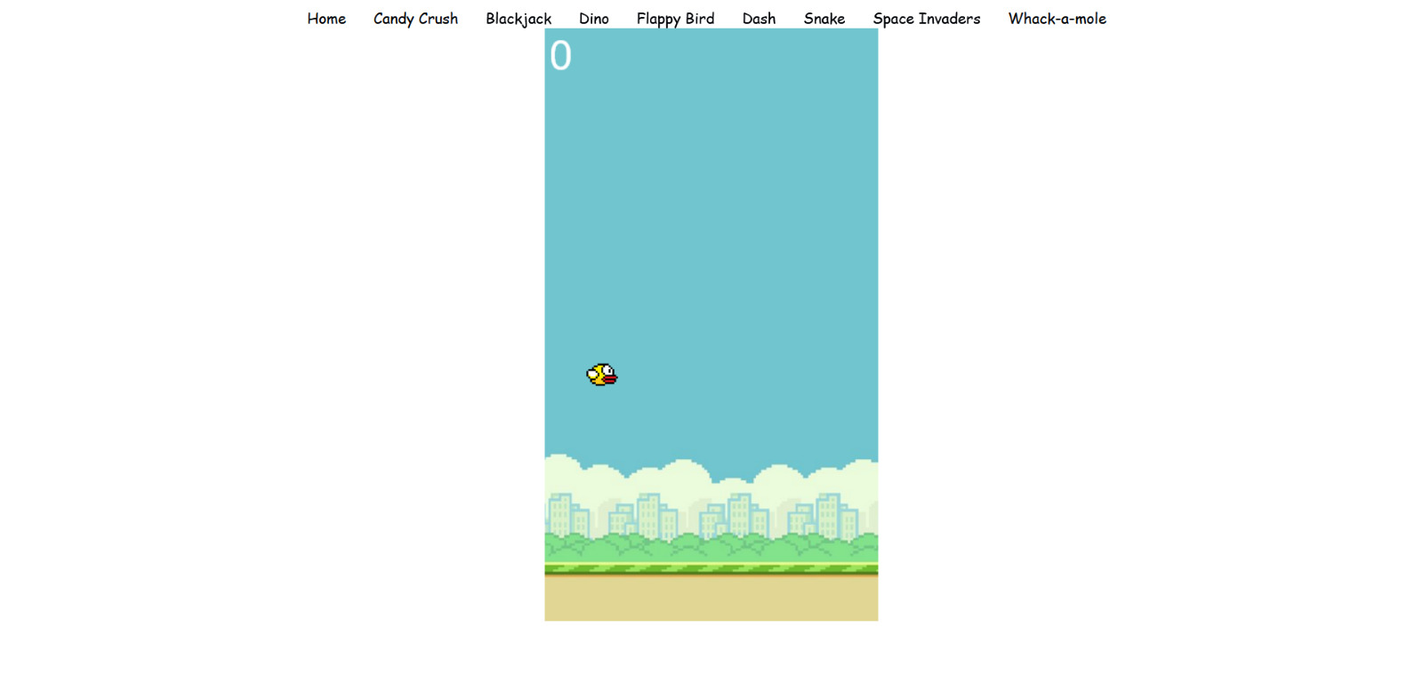

Slide 36
//bird let birdWidth = 34; let birdHeight = 24; let birdX = boardWidth/8; let birdY = boardHeight/2; let birdImg; let bird = { x : birdX, y : birdY, width : birdWidth, height : birdHeight } let velocityX = -2; //pipes moving left speed let velocityY = 0; //bird jump speed let gravity = 0.4; window.onload = function() { birdImg = new Image(); birdImg.src = "./flappybird.png"; birdImg.onload =
function() { context.drawImage(birdImg, bird.x, bird.y, bird.width, bird.height); } } function update() { requestAnimationFrame(update); if (gameOver) { return; } context.clearRect(0, 0, board.width, board.height); //bird velocityY += gravity; bird.y = Math.max(bird.y + velocityY, 0); context.drawImage(birdImg, bird.x, bird.y, bird.width, bird.height); //... } function moveBird(e) { if (e.code == "Space" || e.code == "ArrowUp" || e.code == "KeyX") { //jump velocityY = -6; //reset game if (gameOver) { bird.y = birdY; //... } } }

Slide 37
Future plans
As we conclude the presentation on the Game World web application, let's take a look at the next steps and future plans for the application. Here's what we have in store:

Slide 38
Continuous Game Developement
We are committed to enhancing the gaming experience on Game World by regularly developing and adding new games to the platform. Our team will focus on creating innovative and engaging game concepts that cater to a wide range of player interests.

Slide 39
Player Feedback and Suggestions
We highly value the input of our players. We will establish a robust feedback mechanism to encourage users to share their thoughts, suggestions, and ideas for new games. This will help us tailor the gaming experience to better meet the expectations and preferences of our player community.

Slide 40
Improved User Interface and Experience
Our development team will work on refining the user interface (UI) and user experience (UX) of the Game World application. We will conduct thorough usability testing, gather user feedback, and implement enhancements to ensure intuitive navigation, visually appealing graphics, and smooth gameplay.

Slide 41
Integration of Social Features
We recognize the importance of social interaction in the gaming world. In our future updates, we plan to integrate social features that allow players to connect with friends, share achievements, and compete in multiplayer games. This will foster a sense of community and enhance the overall gaming experience

Slide 42
Mobile Application Developement
To expand our reach and cater to the growing mobile gaming market, we will embark on the development of a Game World mobile application. This will enable users to access and enjoy their favorite games on their smartphones and tablets, providing them with on-the-go entertainment.

Slide 43
By implementing these next steps, we aim to elevate the Game World web application to new heights, offering a diverse and immersive gaming experience that captivates players and keeps them coming back for more. We are excited about the future of Game World and look forward to delivering unparalleled gaming enjoyment to our valued users.

Slide 44
Thank you!

